Slide 1


Slide 2




Slide 3
Using Data to Enable Strategic, Insight-Driven Decisions
Problem Statement:
Atliq Hardware, a major player in the computer hardware industry, encountered a significant challenge. To remain competitive in a rapidly changing market, they needed quicker, data-backed decisions. The management soon recognized that crucial insights were missing, limiting their ability to make strategic moves.
To address this gap, the company is onboarding a data analytics team. I took up the SQL challenge to solve 10 ad-hoc requests and turn the data into actionable insights that support stakeholder decision-making.

Slide 4
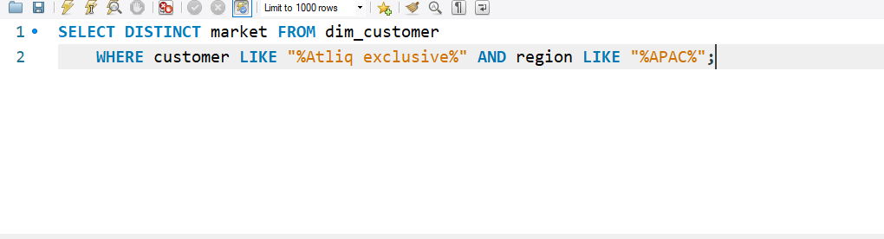
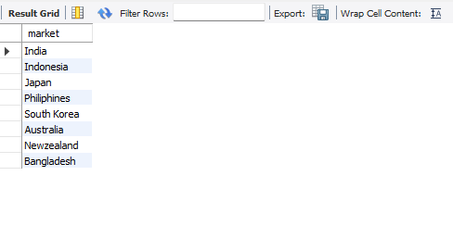
Q) Provide the list of markets in which customer "Atliq Exclusive" operates its business in the APAC region

Slide 5
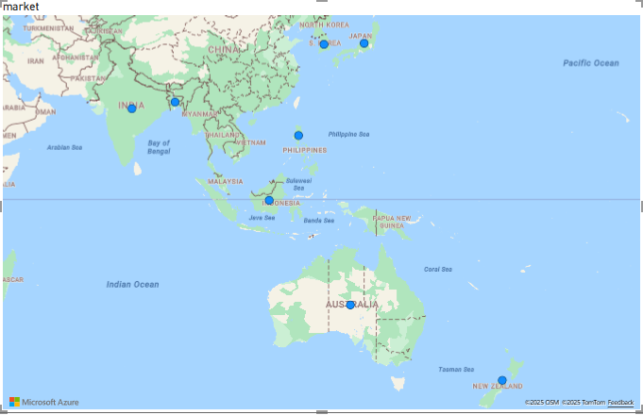
Insight
‘Atliq Exclusive’ is present in 8 out of 10 market places from the APAC region

Slide 6
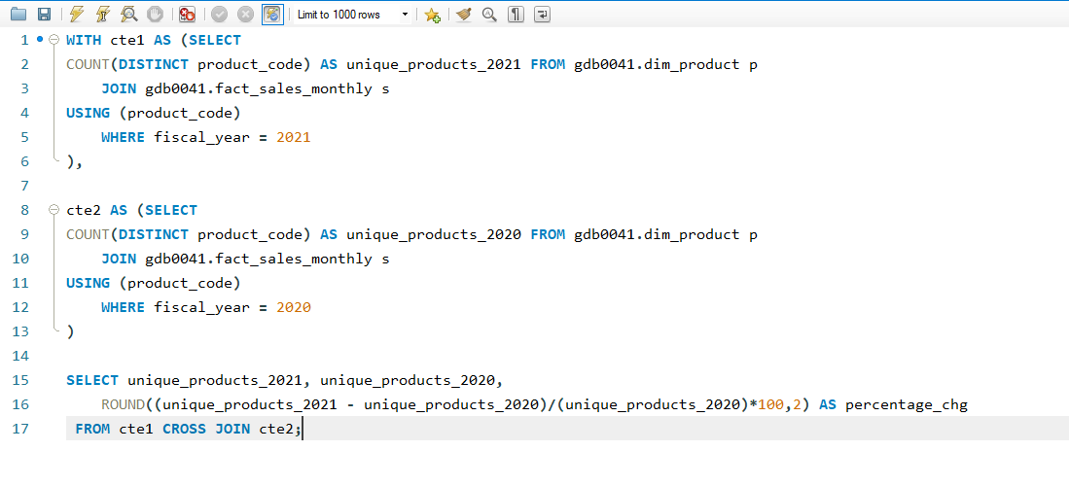
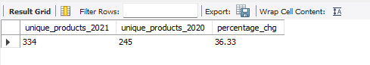
Q) What is the percentage of unique product increase in 2021 vs 2020?

Slide 7
Insight
Here there is no major difference in market size between 2020 to 2021 where as the unique product count has increased to 36.33 % which shows that the demand and supply for the products got a significant increase.

Slide 8
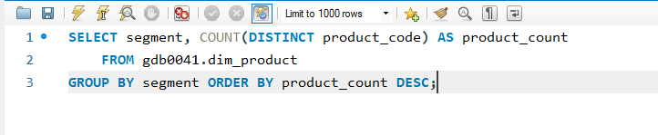
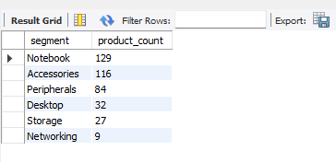
Q) Provide a report with all the unique product counts for each segment and sort them in descending order of product counts.

Slide 9
Insight
Here the least unique product count for the segment is Networking and the Notebook segment is leading the new product due to more demand

Slide 10
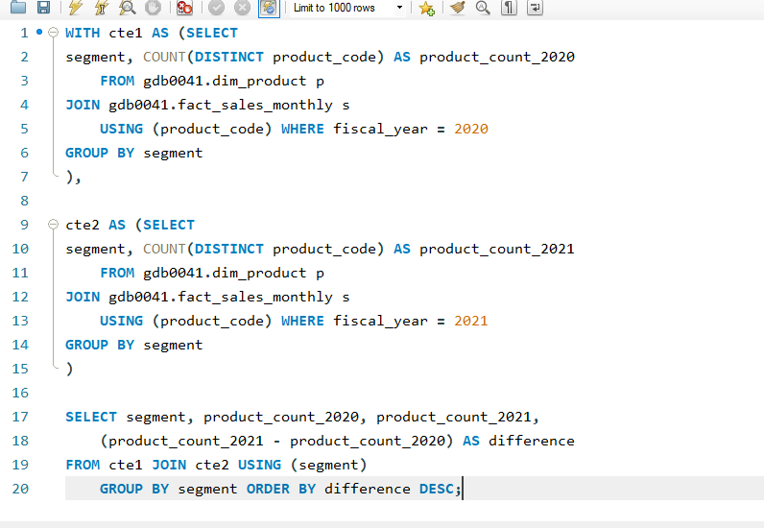
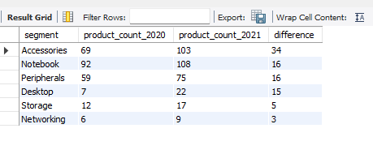
Follow-up: Q) Which segment had the most increase in unique products in 2021 vs 2020?

Slide 11
Insight
From this visual we can say that Storage & Networking segments are being least preferred may be these segments needs to be discontinued and focus on manufacturing unique products for other segments

Slide 12
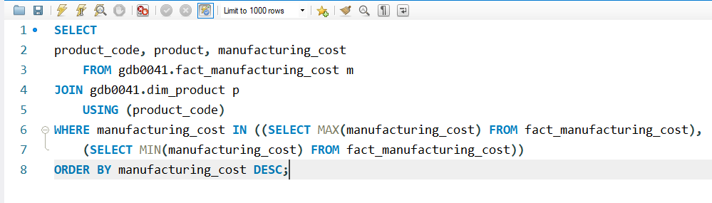
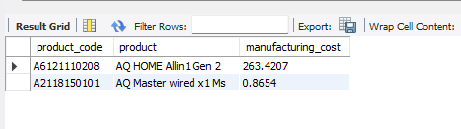
Q) Get the products that have the highest and lowest manufacturing costs.

Slide 13
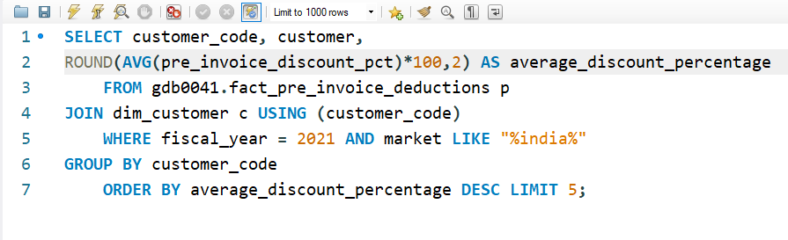
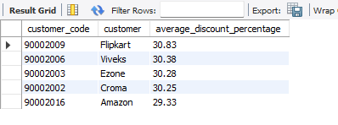
Q) Generate a report which contains the top 5 customers who received an average high pre invoice discount_pct for the fiscal year 2021 and in the Indian market.
Insight: From the result we can see that Flipkart tops the list where as for the remaining customers the discount % is almost close to each other

Slide 14
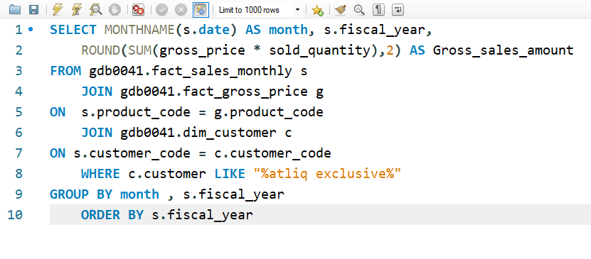
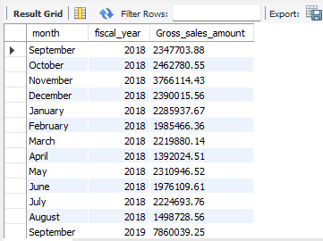
Q) Get the complete report of the Gross sales amount for the customer ‘Atliq Exclusive’ for each month. This analysis helps to get an idea of low and high-performing months and take strategic decisions.

Slide 15
Insight
This chart is for the FY 2020 where the sales of ‘Atliq hardware’ got a huge decline in the month of March 2019 up to August which is due to pandemic, later again the sales started getting increased from the month of November and performed well amongst its competitors.

Slide 16
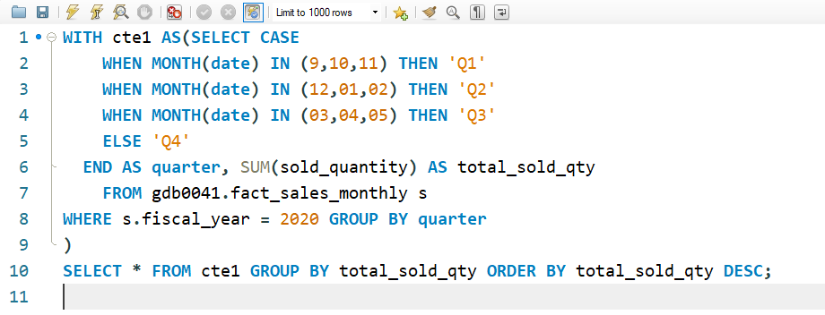
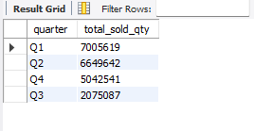
Q) In which quarter of 2020, got the maximum total_sold_quantity?

Slide 17
Insight
The sales in the 3rd quarter are much lower when compared with other quarters which can be due to less promotional offers or discounts.

Slide 18
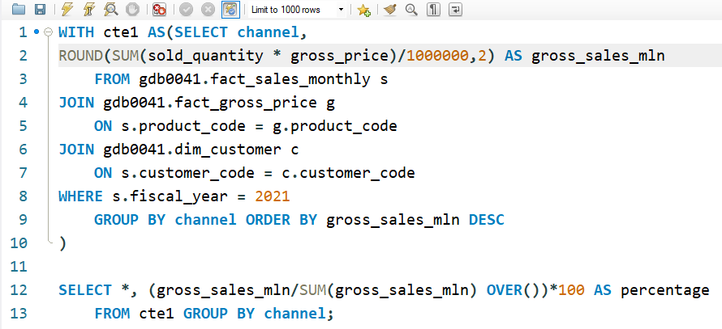
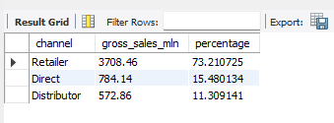
Q) Which channel helped to bring more gross sales in the fiscal year 2021 and the percentage of contribution?

Slide 19
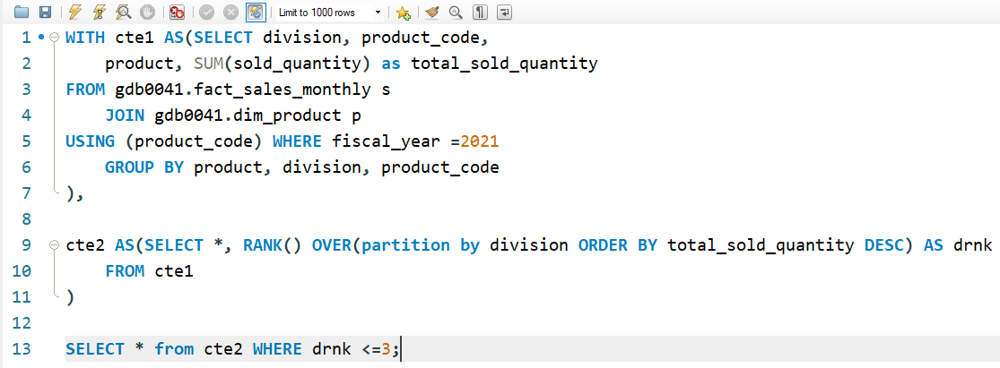
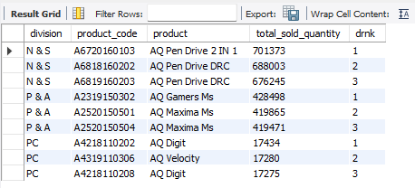
Q) Get the Top 3 products in each division that have a high total_sold_quantity in the fiscal_year 2021?

Slide 20


prashanth.saitw@gmail.com

